Slide 1
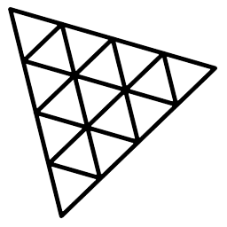
Three.js
3.JS
is
awesome
GUIDE FOR BEGINNERS
PROJECT PROPOSAL

Slide 2
TOPIC 9:
ABOUT
BUDGET
PROJECT
TIMELINE
DEBUG-UI
PROJECT PROPOSAL

Slide 3
WHAT IS DEBUG-UI
TABLE OF CONTENTS
DAT-UI OR LIL-UI
INSTALLATION AND IMPLEMENTATION OF LIL-UI
What is debug-ui
Dat-ui or Lil-ui
Installation and Implementation of lil-ui
01
02
03
PROJECT PROPOSAL

Slide 4

What is debug-ui
What is debug-ui
Dat-ui or Lil-ui
Installation and Implementation of lil-ui
01

Slide 5
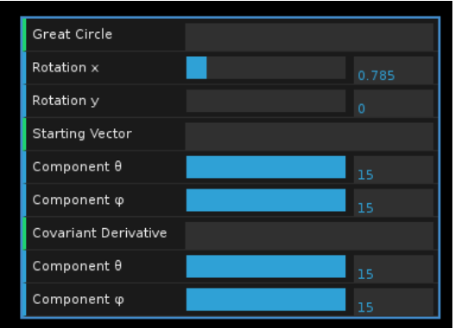
What is debug-ui
Dat-ui or Lil-ui
Installation and Implementation of lil-ui
When we are creating scene and want to make it perfect, we have to change and check every parameter of different objects in order for the scene to look perfect. And it takes too much time and effort if we do it manually.
That’s why we use DEBUG UI.
It is a lightweight graphical user interface for changing variables.
There are many libraries for that purpose like dat.gui,lil.gui,control-panel,Uil,Tweakpane, Guifi etc.

Slide 6

Dat-ui or Lil-ui?
What is debug-ui
Dat-ui or Lil-ui
Installation and Implementation of lil-ui
02

Slide 7
What is debug-ui
Dat-ui or Lil-ui
Installation and Implementation of lil-ui
In general dat.GUI is very popoular for changing parameters but it has not been updated for a long time and we might get some vulnerabilities warnings.
So there is an alternative for dat.GUI which is lil.GUI and that is very similar to lil.GUI and we will be using lil.GUI.

Slide 8
Installation and Implementation of lil-ui
What is debug-ui
Dat-ui or Lil-ui
Installation and Implementation of lil-ui
03

Slide 9
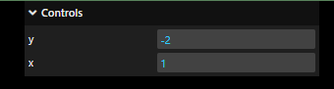
What is debug-ui
Dat-ui or Lil-ui
Installation and Implementation of lil-ui
Installation:
For installation of lil-ui, we just have to write the following code in the terminal in the folder in which we are doing our project;
npm i lil-gui
Implementation:
To get starting, following is the code of a very basic lil.gui.
import * as dat from "lil-gui";
const gui=new dat.GUI();
gui.add(cube.pos,'y')
gui.add(cube.pos,‘x')
So it actually controls the position of the cube.

Slide 10

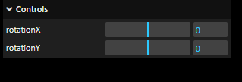

What is debug-ui
Dat-ui or Lil-ui
Installation and Implementation of lil-ui
Code to add Slider:
gui.add(cube.position, 'z').min(- 3).max(3).step(0.01)
Code for rotation of the cube:
gui.add(cube.rotation,'x').min(-5).max(5).step(0.01).name("rotationX")
gui.add(cube.rotation,'y').min(-5).max(5).step(0.01).name("rotationY")
Code for animating the cube:
const parameters={
spining:()=>{
gsap.to(cube.rotation,{duration:1,y:cube.rotation.x+10})
}
} gui.add(parameters,'spining')

Slide 11
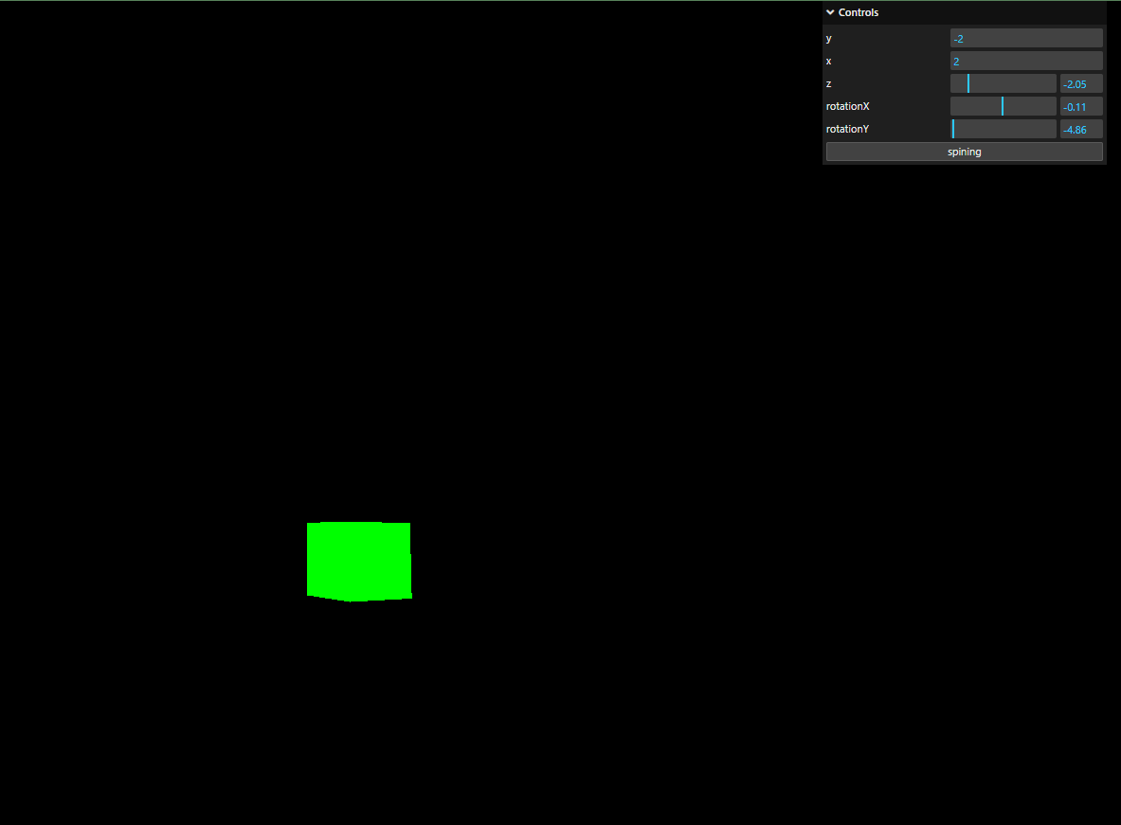
What is debug-ui
Dat-ui or Lil-ui
Installation and Implementation of lil-ui

Slide 12
THANKS!
ABOUT
BUDGET
PROJECT
TIMELINE
Do you have any questions?
EMAIL: aadnanshahh2001@gmail.com
GITHUB: https://github.com/AdnanShahSahb
Please keep this slide for attribution
PROJECT PROPOSAL

